Slide 1
Problem Reduction
-AND-OR Graph
-AO* Search

Slide 2
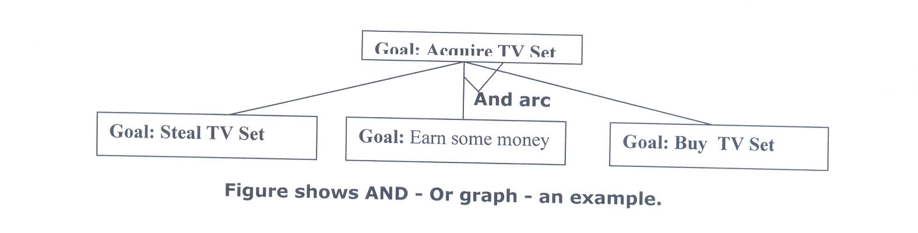
AND OR Graph
When a problem can be divided into a set of sub problems, where each sub problem can be solved separately and a combination of these will be a solution, AND-OR graphs or AND - OR trees are used for representing the solution.
The decomposition of the problem or problem reduction generates AND arcs. One AND are may point to any number of successor nodes.
All these must be solved so that the arc will rise to many arcs, indicating several possible solutions. Hence the graph is known as AND - OR instead of AND.

Slide 3
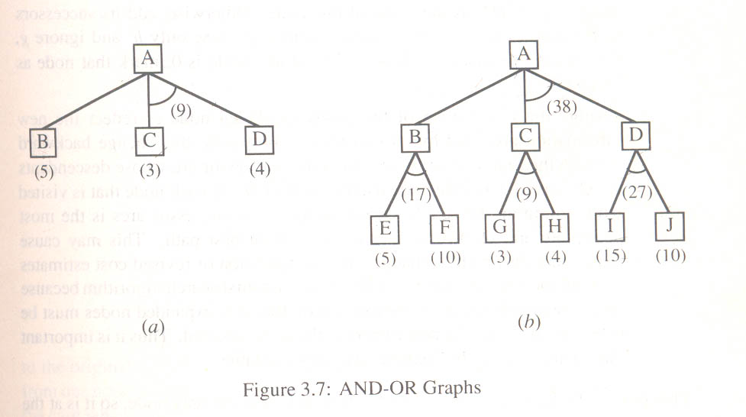


Slide 4
We can see that to search an AND-OR graph, the following three things must be done.
1. traverse the graph starting at the initial node and following the current best path, and accumulate the set of nodes that are on the path and have not yet been expanded.
2. Pick one of these unexpanded nodes and expand it. Add its successors to the graph and computer f ' (cost of the remaining distance) for each of them.
3. Change the f ' estimate of the newly expanded node to reflect the new information produced by its successors. Propagate this change backward through the graph. Decide which of the current best path.

Slide 5
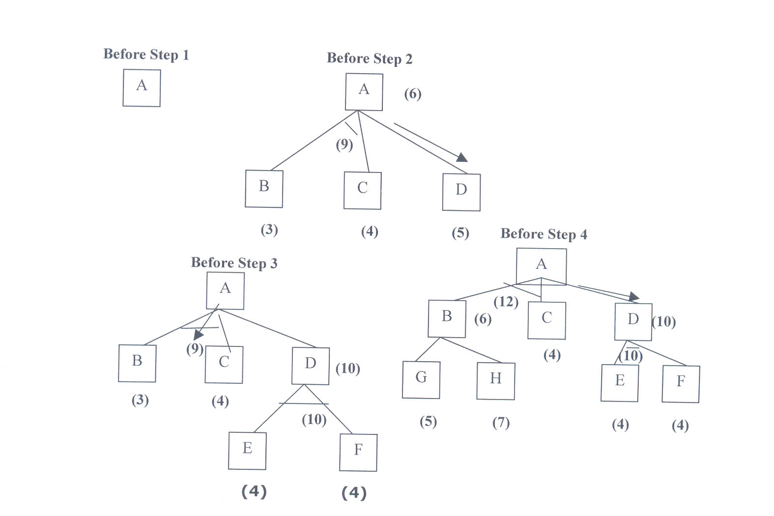
The propagation of revised cost estimation backward is in the tree is not necessary in A* algorithm. This is because in AO* algorithm expanded nodes are re-examined so that the current best path can be selected.

Slide 6
AO* Search Procedure.
1. Place the start node on open.
2. Using the search tree, compute the most promising solution tree TP .
3. Select node n that is both on open and a part of tp, remove n from open and place it no closed.
4. If n is a goal node, label n as solved. If the start node is solved, exit with success where tp is the solution tree, remove all nodes from open with a solved ancestor.
5. If n is not solvable node, label n as unsolvable. If the start node is labeled as unsolvable, exit with failure. Remove all nodes from open ,with unsolvable ancestors.
6. Otherwise, expand node n generating all of its successor compute the cost of for each newly generated node and place all such nodes on open.
7. Go back to step(2)

Slide 7
AND-OR Graphs
Initialize the graph to the starting node.
2. Loop until the starting node is labeled SOLVED or until its cost goes above FUTILITY:
(a) Traverse the graph, starting at the initial node and following the current best path, and accumulate the set of nodes that are on that path and have not yet been expanded or labeled as solved.
(b) Pick one of these unexpanded nodes and expand it. If there are no successors, assign FUTILITY as the value of this node. Otherwise, add its successors to the graph and for each of them compute f ′ (use only h′ and ignore g, for reasons we discuss below). If of any node is 0, mark that node as SOLVED.
(c) Change the f ′ estimate of the newly expanded node to reflect the new information provided by its successors. Propagate this change backward through the graph. If any node contains a successor arc whose descendants are all solved, label the node itself as SOLVED. At each node that is visited while going up the graph, decide which of its successor arcs is the most promising and mark it as part of the current best path.
60

Slide 8
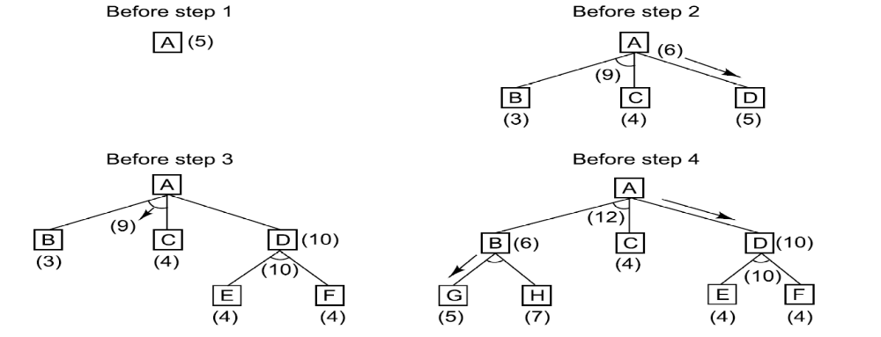
The Operation of Problem Reduction
61

Slide 9
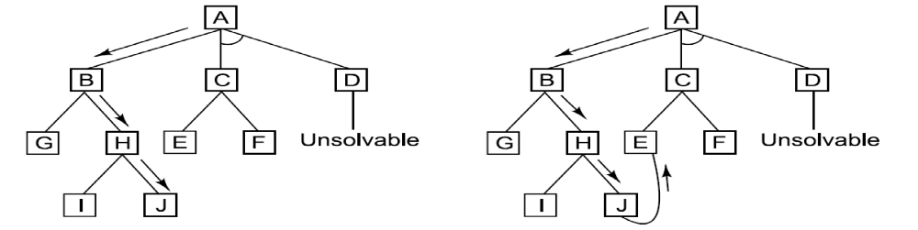
A Longer Path May Be Better
62

Slide 10
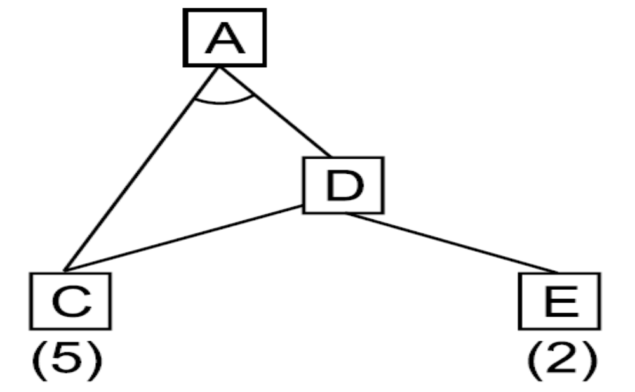
Interacting Subgoals
63

Slide 11
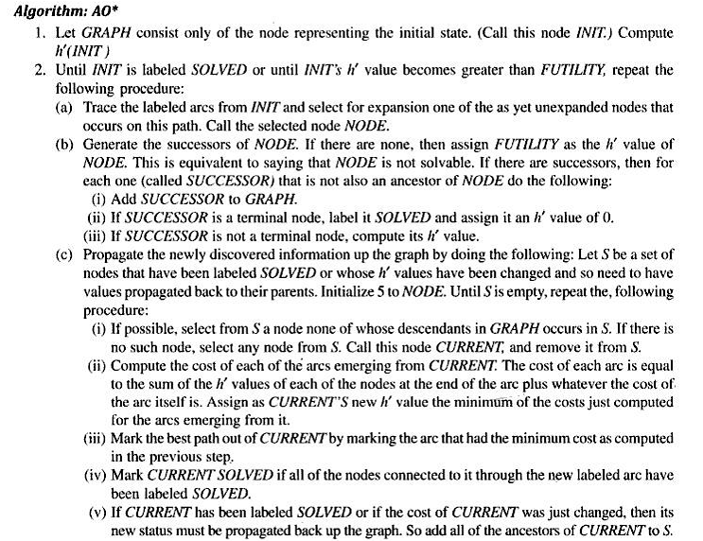

Slide 12
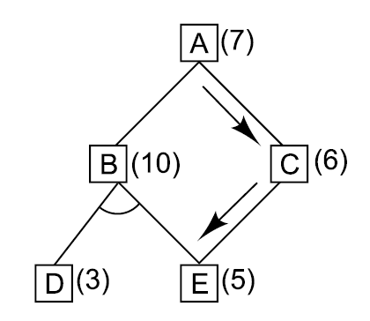
Backward Propagation
64

Slide 13
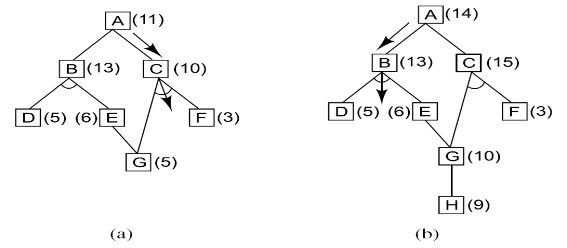
A Necessary Backward Propagation
65

Slide 14

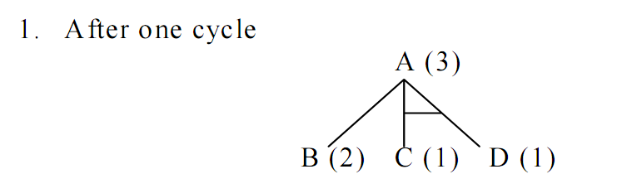
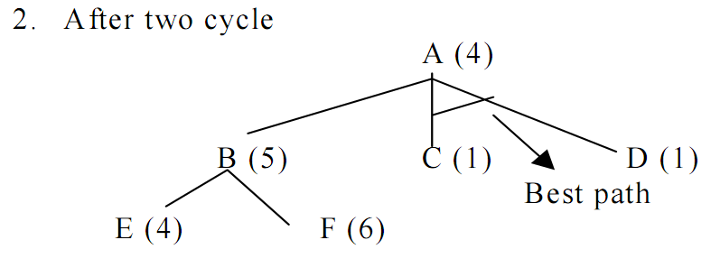

Slide 15
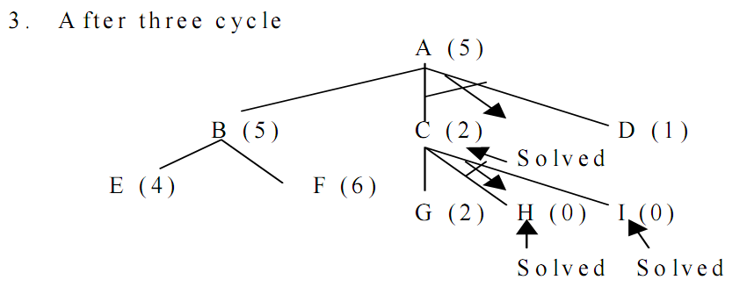

Slide 16
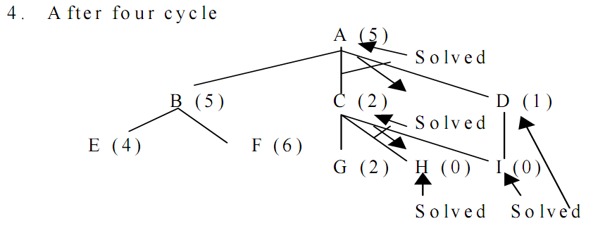

Slide 17
Constraint Satisfaction
Constraint Satisfaction
  The goal is to discover some problem state that satisfies a given set of constraints. E.g. Puzzles, real-world perceptual labeling problems, design tasks etc.
  Helps in reducing the amount of search required as compared with a method that attempts to form partial solutions directly by choosing specific values for components of the eventual solution.
  The fundamental issue is to include restrictions first that can be inferred from the rules of arithmetic. This reduces the number of guesses.
  The initial state contains the constraints that are originally given in the problem description.
  A goal state is any state that has been constrained enough, enough has to be defined for each problem.

Slide 18
Constraint Satisfaction
  It is a 2 step process.
    First, constraints are discovered and propagated as far as possible throughout the system.
    Then, if there is still no solution, search begins. A guess about something is made and added as a new constraint. Propagation can then occur with this new constraint and so forth.

Slide 19
Algorithm : Constraint Satisfaction
1. Propagate available constraints. To do this, first set OPEN to the set of all objects that must have values assigned to them in a complete solution. Then do until an inconsistency is detected or until OPEN is empty:
(a) Select an object OB from OPEN. Strengthen as much as possible the set of constraints that apply to OB.
(b) If this set is different from the set that was assigned the last time OB was examined or if this is the first time OB has been examined, then add to OPEN all objects that share any constraints with OB.
(c) Remove OB from OPEN.
2. If the union of the constraints discovered above defines a solution, then quit and report the solution.
3. If the union of the constraints discovered above defines a contradiction, then return failure.
4. If neither of the above occurs, then it is necessary to make a guess at something in order to proceed. To do this, loop until a solution is found or all possible solutions have been eliminated:
(a) Select an object whose value is not yet determined and select a way of strengthening the constraints on that object.
(b) Recursively invoke constraint satisfaction with the current set of constraints augmented by the strengthening constraint just selected.
66

Slide 20
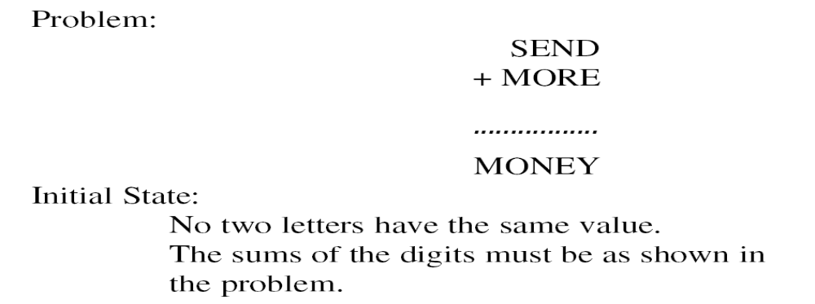
A Cryptarithmetic Problem
67

Slide 21
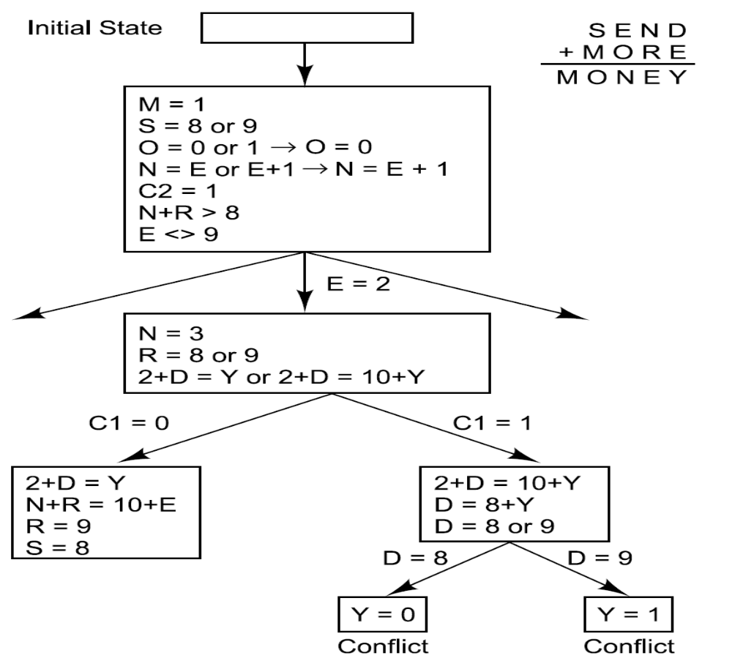
Solving a Cryptarithmetic Problem
68

Slide 22
From column 5, M = 1 since it is the only carry-over possible from the sum of two single digit numbers in column 4.
Since there is a carry in column 5, and M = 1, then O = 0
Since O = 0 there cannot be a carry in column 4 (otherwise N would also be 0 in column 3) so S = 9.
If there were no carry in column 3 then E = N, which is impossible. Therefore there is a carry and N = E + 1.
If there were no carry in column 2, then ( N + R ) mod 10 = E, and N = E + 1, so ( E + 1 + R ) mod 10 = E which means ( 1 + R ) mod 10 = 0, so R = 9. But S = 9, so there must be a carry in column 2 so R = 8.
To produce a carry in column 2, we must have D + E = 10 + Y.
Y is at least 2 so D + E is at least 12.
The only two pairs of available numbers that sum to at least 12 are (5,7) and (6,7) so either E = 7 or D = 7.
Since N = E + 1, E can't be 7 because then N = 8 = R so D = 7.
E can't be 6 because then N = 7 = D so E = 5 and N = 6.
D + E = 12 so Y = 2.

Slide 23
Means-Ends Analysis
Means-Ends analysis
  So far, we have presented a collection of search strategies that can reason either forward or backward, but for a given problem, one direction or the other must be chosen. Often, however a mixture of two directions is appropriate.
  By doing this we can solve the major part of problem first and then go back and solve the small problems that arise in putting the big picture together.
  The technique is called, means-ends analysis.
  It processes the centers around the detection of differences between the current state and the goal state. Once that difference is found , and operator that can reduce the difference must be found.
  Divide the problem into sub-problems.

Slide 24
Means-end analysis
Reducing differences between current state and goal state
  Stop when difference is 0 (no difference)
Subgoals
  Intermediate goals – not your final goal-state
  Means-end analysis is also considered a way to break up a problem into pieces (subgoals)

Slide 25
Means-Ends Analysis as it was employed in GPS.
The example problem that we consider is to 'go from your house in New Brunswick to your Aunt's House in Los Angeles.'
GPS required knowledge about the problem domain.
This knowledge was represented in a Difference-Operator Table. This table provides the knowledge needed to decompose a problem into subproblems..

Slide 26
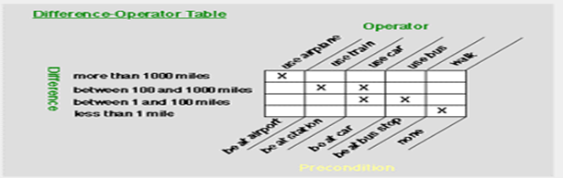
Means-Ends Analysis as it was employed in GPS.
The basic idea that underlies Means-Ends Analysis is that the planner has the ability to compare two problem states and determine one or more ways in which these problem states differ from each other.
The rows of this example table lists a way in which two problem states might differ.
The labels at the top of the columns list an operator (action) that can reduce the difference.
And, the labels at the bottom of the columns list the partial state description that must be satisfied in order for the operator to be applied.

Slide 27
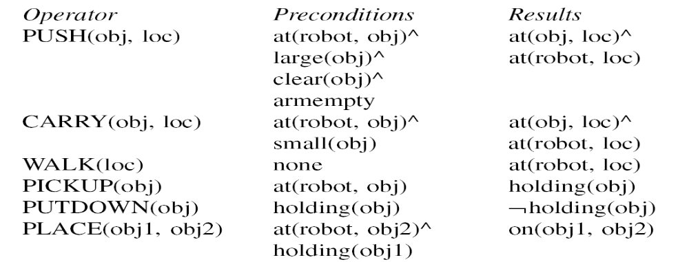
A Robot’s Operators
Consider a Simple household robot domain. The available operators with preconditions
And results are given bellow:
69

Slide 28
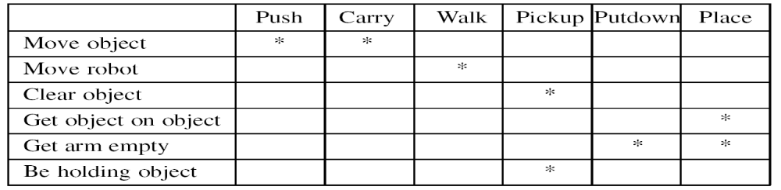
A Difference Table
Describes that describes when each of operator is appropriate
Given a Problem of moving a desk with two things on it from one room to another.
70

Slide 29
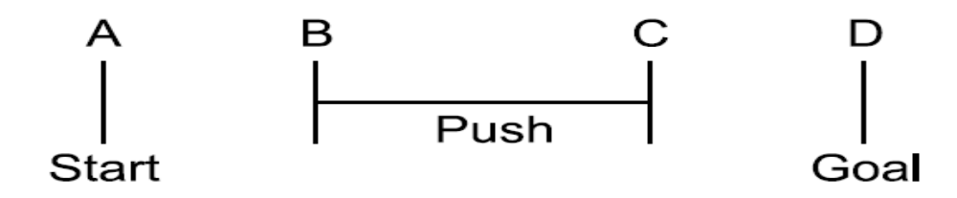
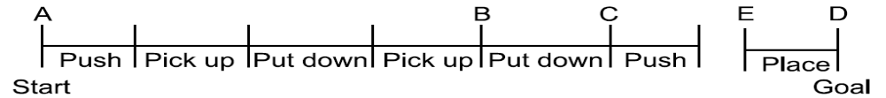
The Progress of the Means-Ends Analysis Methods
71

Slide 30
Algorithm : Means-Ends Analysis
Compare CURRENT to GOAL. If there are no differences between them then return.
2. Otherwise, select the most important difference and reduce it by doing the following until success or failure is signaled:
Select an as yet untried operator O that is applicable to the current difference. If there are no such operators, then signal failure.
(b) Attempt to apply O to CURRENT. Generate descriptions of two states: O-START, a state in which O’s preconditions are satisfied and O-RESULT, the state that would result if O were applied in OSTART.
(c) If
(FIRST-PART ← MEA(CURRENT, O-START))
and
(LAST-PART ← MEMO-RESULT, GOAL))
are successful, then signal success and return the result of concatenating
FIRST-PART, O, and LAST-PART.
72

Slide 31


